Slide 1

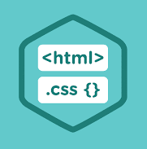
HTML and CSS

Slide 2

HTML Basics

Slide 3
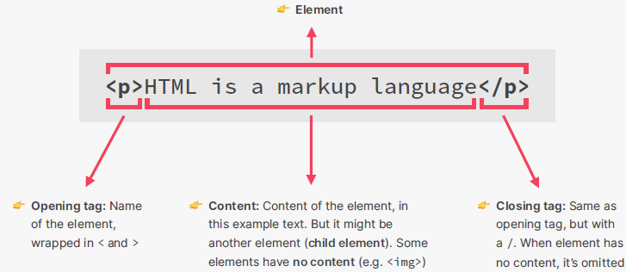
Understanding HTML Basics
HTML (HyperText Markup Language) is the standard language for creating web pages.
It describes the structure of a web page using markup.
Markup languages define where a specific content starts and ends, often providing a description of that content.
HTML elements are the building blocks of HTML pages.
These elements are represented by tags such as <html>, <body>, <div>, <span>, <p>, etc.
https://www.w3schools.com/html/default.asp

Slide 4
HTML Basics
Element
Attribute
Value
Attribute
Value
Content
<a href="https://www.dalarna.se" class="link">Besök Dalarna</a>
Opening tag
Closing tag

Slide 5
HTML Basics
Elements can have multiple attributes. But there are two types:
General attributes that describe things
Identifying attributes that pinpoint specifics.
<img src="images/logotype.svg" alt="Company Logotype" class="logotype">
1
1
2
Each new attribute in the element is preceded by a space
The order of the attributes does not matter for how the code is interpreted and executed, but the order may matter for readability
https://www.w3schools.com/tags/ref_attributes.asp

Slide 6
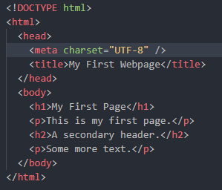
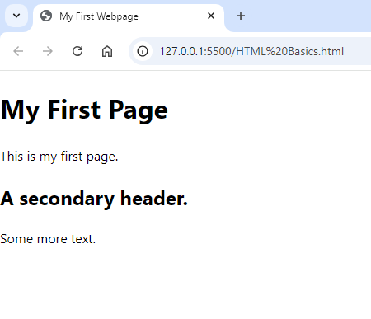
The <!DOCTYPE html> declaration defines that this document is an HTML5 document
The <html> element is the root element of an HTML page, the container for all other HTML elements on the page. It essentially defines the start and end of an HTML document.
The <head> element contains meta information about the HTML page, which is not displayed directly to the user.
The <meta> element specifies the character encoding for the HTML document.
The <title> element specifies a title for the HTML page (which is shown in the browser's title bar or in the page's tab)
The <body> element defines the document's body, and is a container for all the visible contents, such as headings, paragraphs, images, hyperlinks, tables, lists, etc.
The <h1> element defines a large heading
The <h2> element defines a secondary heading
The <p> element defines a paragraph

Slide 7
HTML5 Semantic Elements

Slide 8
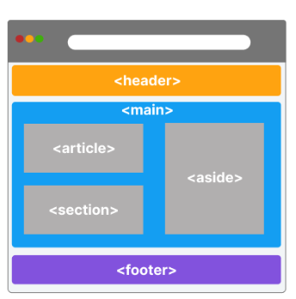
HTML Semantic Elements
Semantic elements = elements with a meaning
Semantic elements clearly describe their meaning in a human- and machine-readable way.
They provide better accessibility and Search Engine Optimization, as browsers and search engines understand the structure and meaning of the webpage.
Examples of non-semantic elements: <div>, <span>
Examples of semantic elements: <header>, <footer>, <article>, <section>, <nav>. <h1> to <h6> etc.
https://www.w3schools.com/html/html5_semantic_elements.asp

Slide 9
HTML Semantic Elements
Tag | Description
<header> | Specifies a header for a document or section
<main> | Specifies the main content of a document
<nav> | Defines navigation links
<article> | Defines independent, self-contained content
<section> | Defines a section in a document
<figure> | Specifies self-contained content, like illustrations, diagrams, photos,etc.
<aside> | Defines content aside from the page content
<footer> | Defines a footer for a document or section
<ul> | Defines an unordered list
<ol> | Defines an ordered list
<li> | Defines a list item
https://www.w3schools.com/tags/default.asp

Slide 10
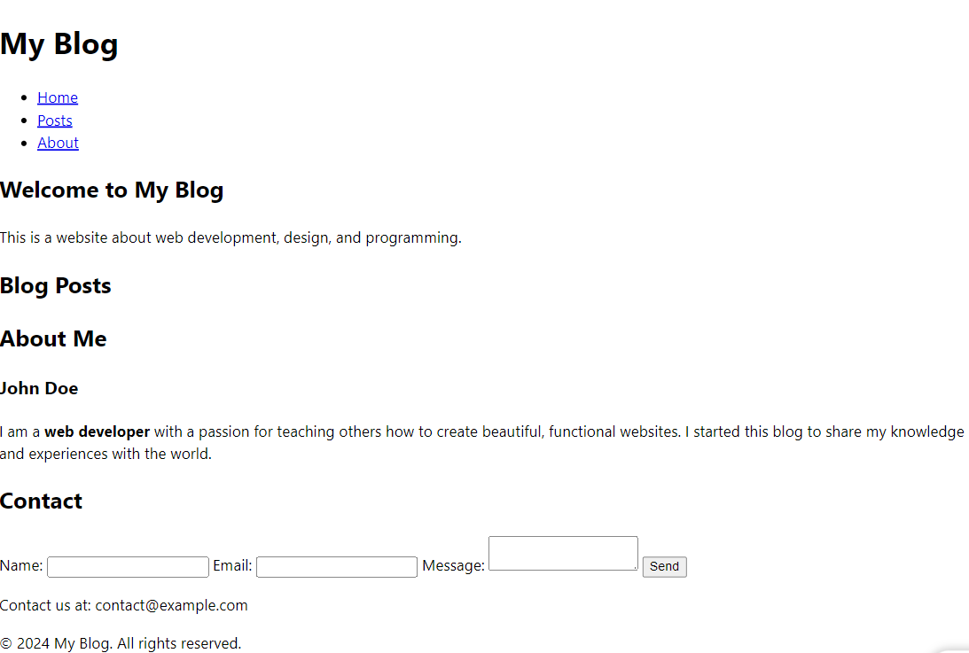
HTML Example

Slide 11
CSS

Slide 12
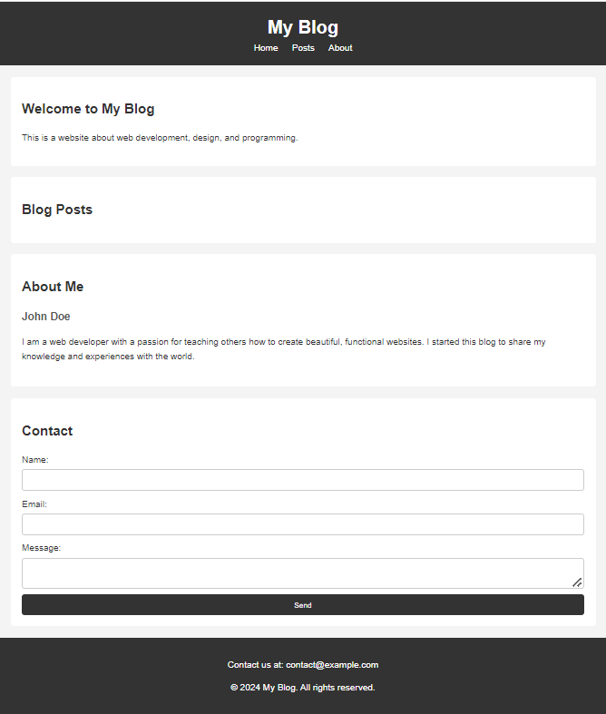
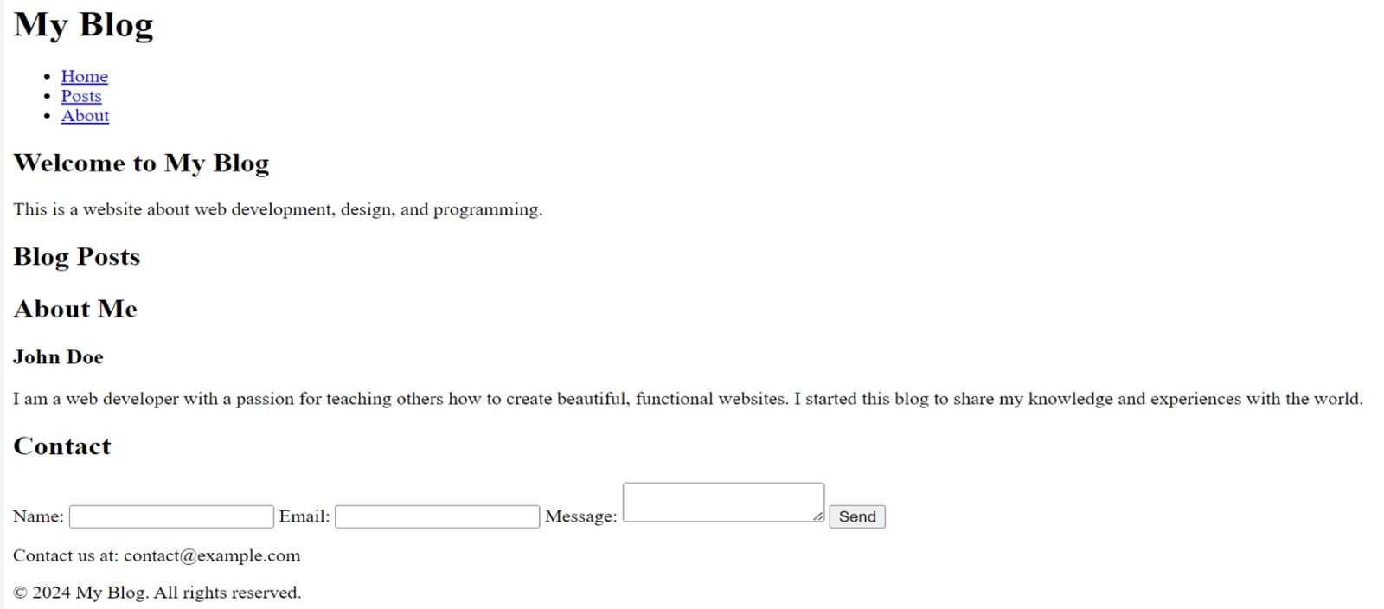
What is CSS
CSS stands for Cascading Style Sheets.
CSS describes the visual style and presentation of the content written in HTML
CSS consist of countless properties that developers use to format the content: properties about font, text, spacing, layout, etc.
https://www.w3schools.com/css/default.asp

Slide 13
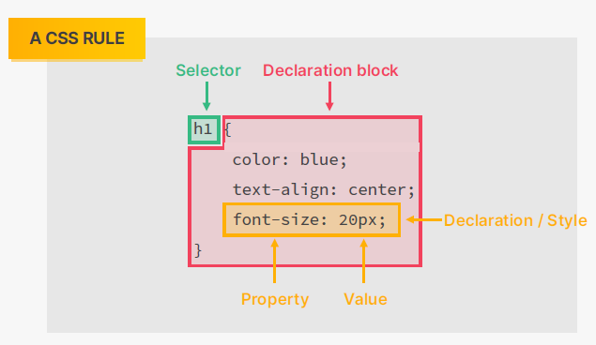
CSS Ruleset

Slide 14
CSS Selectors
🤔 There are multiple selectors selecting the same element. Which one of them applies?
🤓 All of them. All rules and properties are applied!
🤔 But there are conflicting font-size declarations! Is it 18px, or 20px, or 22px?
🤓 Let’s see how it works...

Slide 15
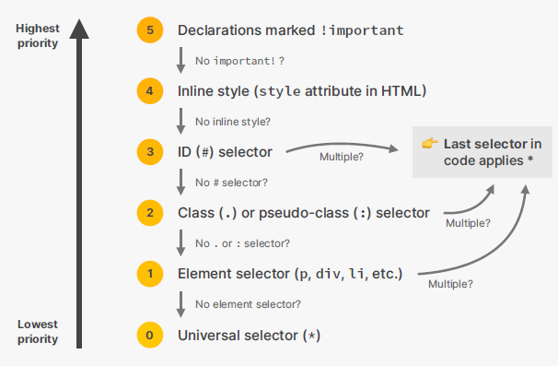
👉 There is an ID selector (#author-text), so for the conflicting font-size property, this is the selector that applies

Slide 16
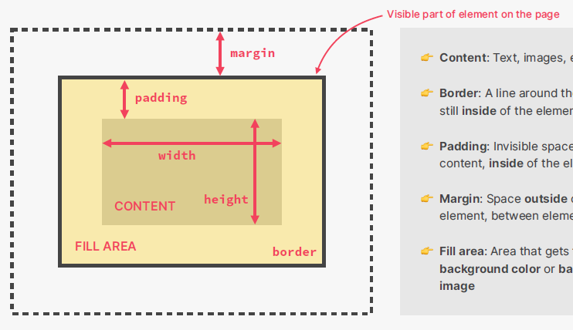
The CSS Box Model
Content: Text, images, etc.
Border: A line around the element, still inside of the element
Padding: Invisible space around the content, inside of the element
Margin: Space outside of the element, between elements
Fill area: Area that gets filled with background color or background image
Final element width = left border + left padding + width + right padding + right border
Final element height = top border + top padding + height + bottom padding + bottom border
This is the default behavior, but we can change it

Slide 17
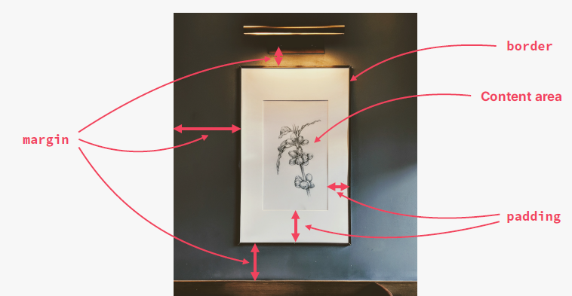
Analogy for the CSS Box Model

Slide 18
Block-level Elements
Elements are formatted visually as blocks
Elements occupy 100% of parent element’s width, no matter the content
Elements are stacked vertically by default, one after another
The box-model applies as showed earlier
Default elements: body, main, header, footer, section, nav, aside, div, form, h1-h6, p, ul, ol, li, etc.
With CSS: display: block

Slide 19
inline-level Elements
An inline element DOES NOT start on a new line and only takes up as much width as necessary.
👉 Causes no line-breaks after or before the element
👉 Box model applies in a different way: heights and widths do not apply
👉 Paddings and margins are applied only horizontally (left and right)
Default elements: a, strong, em, span, label etc.
With CSS: display: inline

Slide 20
inline-block Elements
An inline-block element Looks like inline from the outside, behaves like block level on the inside
👉 Causes no line-breaks after or before the element -- Inline
👉 Box model applies in a different way: heights and widths applys --block
👉 Paddings and margins are applied both horizontally and vertically, like block level elements --block
Default elements: button, img, input, , textarea etc.
With CSS: display: inline-block
Can a inline element be displayed as block, or inline-block? Or vice versa
YES, of course!
Use the display property.
display:
https://www.w3schools.com/css/css_inline-block.asp

Slide 21

Assignment!

